Slide 1
Circle Store
By jake

Slide 2
Process
Kanban board (Agile).
Risk Assessment.
Devops Technologies – Git

Slide 3
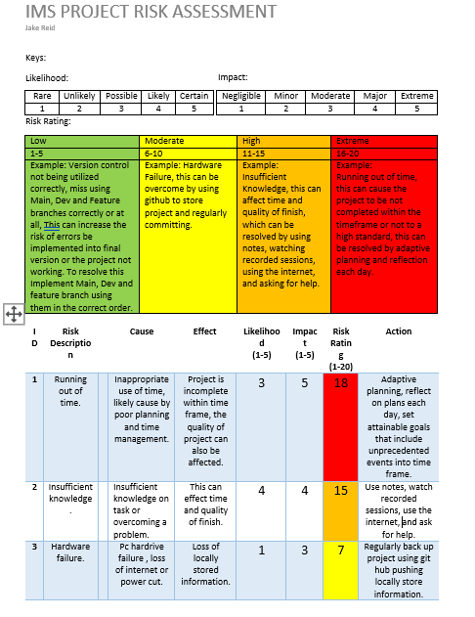
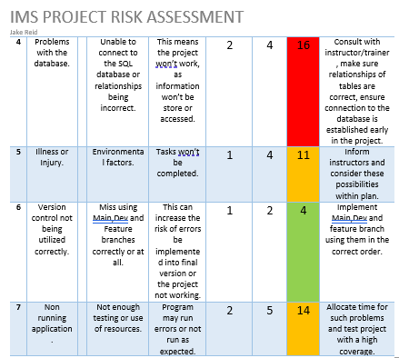
Java/spring
Risk assessment

Slide 4
Data management and it’s process from frontend to backend:
Presentation layer
Business layer
Data layer
(Frontend)
Circle webpage:
HTML
CSS
JS
H2
Database where are customers items and orders are stored.
DTO
Customer
Item
Order
Repo
Controller
Service
Domain
Spring

Slide 5
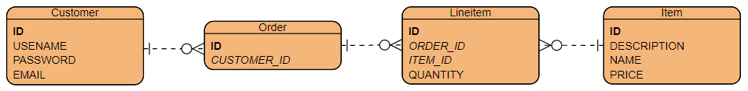
Database , h2

Slide 6
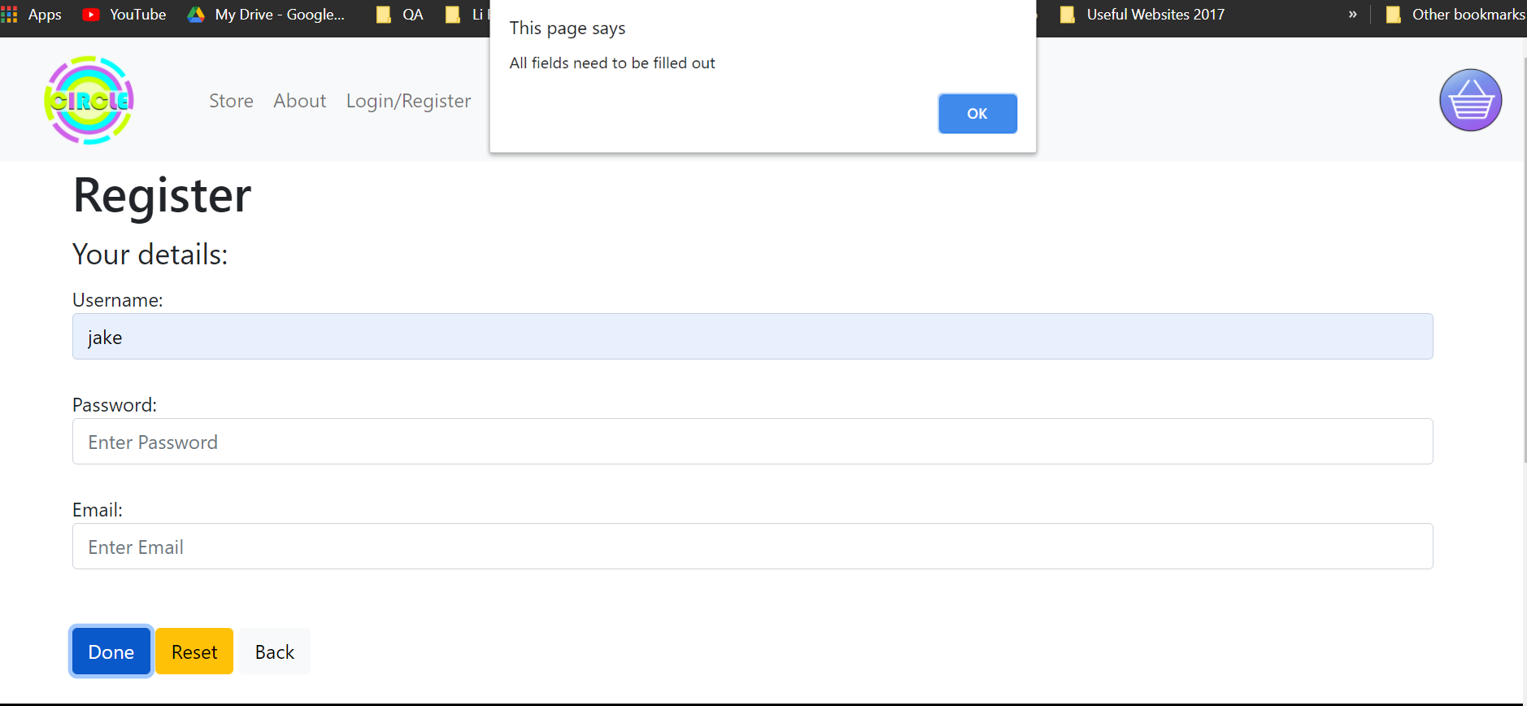
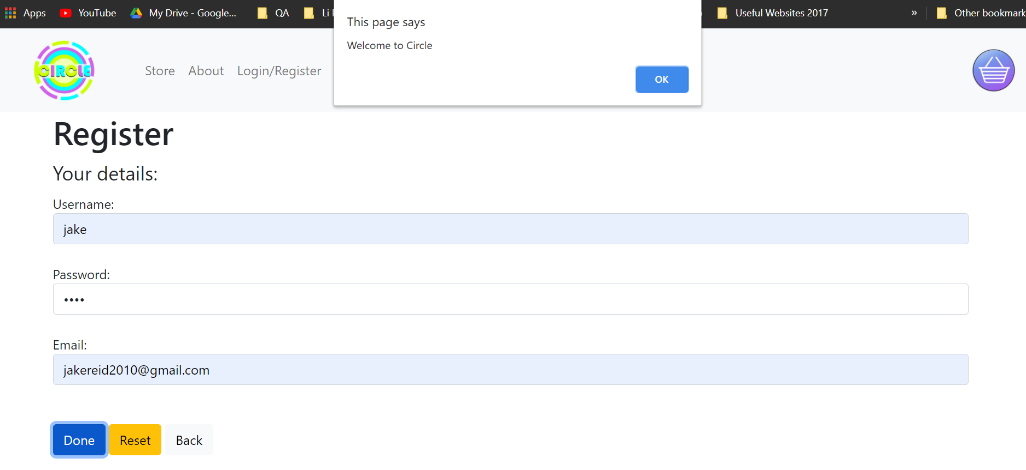
HTML /JAVASCRIPT/CSS (FRONT END)

Slide 7
Consultancy Journey
Jira
D2
Programming Language- Java,javascript,html,css
Testing- Junit , Mockito,
Build tool- Maven
Software applications- SpringToolSuite and Visual Studio Code

Slide 8
Demo

Slide 9
Extras:
Formatting (javascript): Registration page only accepts inputs when the from has been fully completed, using alerts to make sure user is aware what is happening.
Expansion on tables and their relationships
Developing a login feature

Slide 10
REFLECTION
(JAVA)- I need to practice more on my controller and service.
I spent a lot of time on getting my relationships to work, I would not undertake a project of this magnitude within a short time span at the moment.

Slide 11
conclusion
I would undertake the essential amount of work before expanding.

